Slide 1


McCoy Building Energy Dashboard
Link to the Website: https://turnkey-crowbar-351921.uc.r.appspot.com/

Slide 2
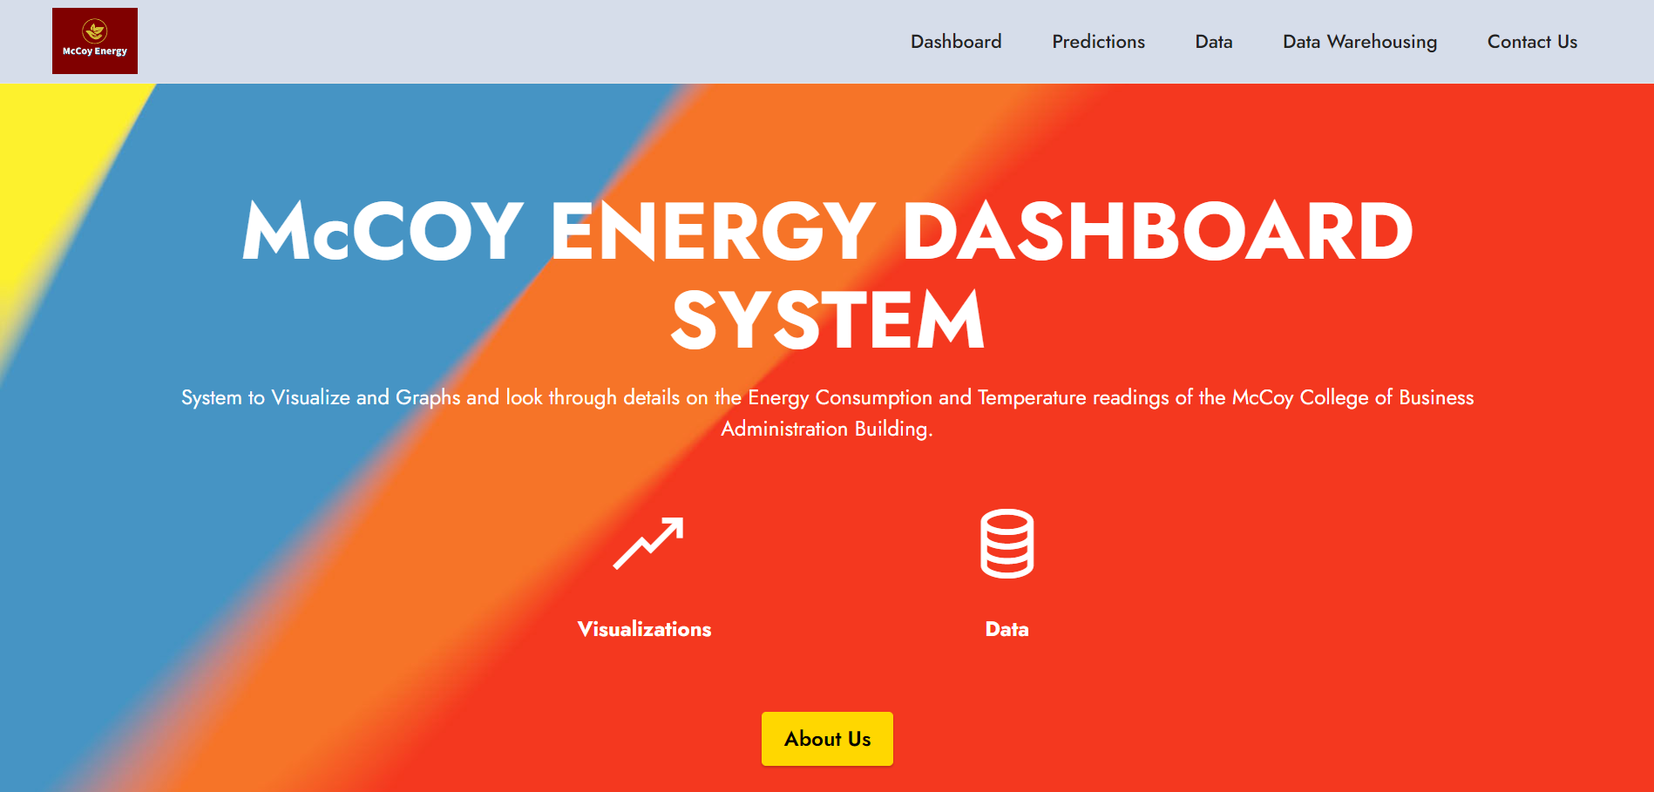

Home Page
This is the Landing / Home page for the Dashboard we have developed.

Slide 3
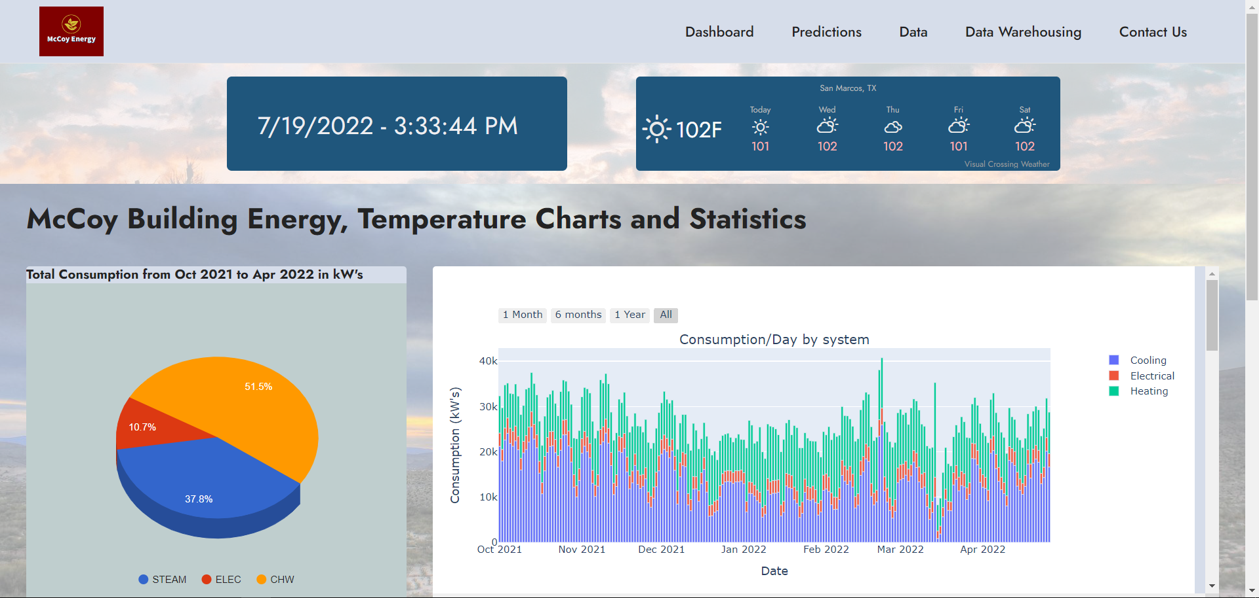
Dashboard Page
The page consists of the Live Date, Time and Temperature of San Marcos. The page also consists of some visualizations such as a pie chart, line charts, bar charts for further description and understanding on the data.

Slide 4
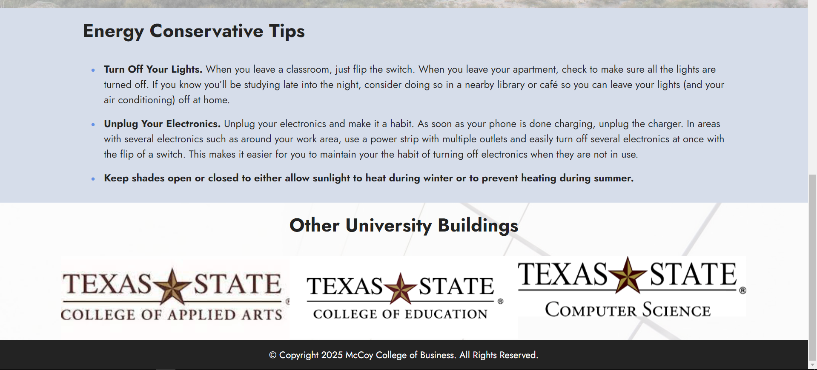
Dashboard Page Continued..
The page also holds some Energy conservative tips. Bottom 3 college logos are placed for future use, i.e. If we plan on using this energy dashboard for the other university buildings.

Slide 5
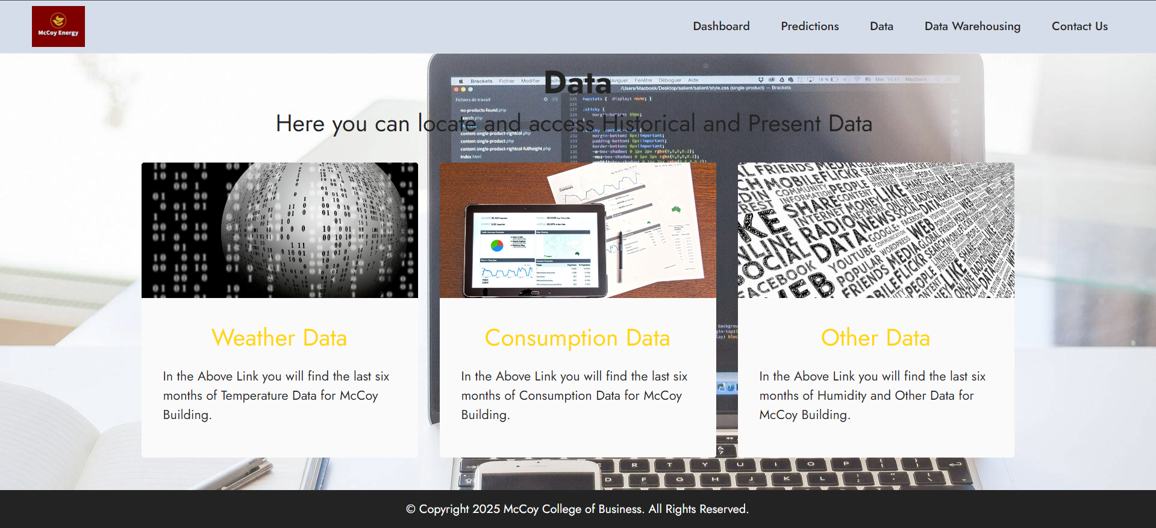
Data Page
This page is from where you can access the data we are using to plot the graphs in the Dashboard Page, also for analysis and predictions.

Slide 6
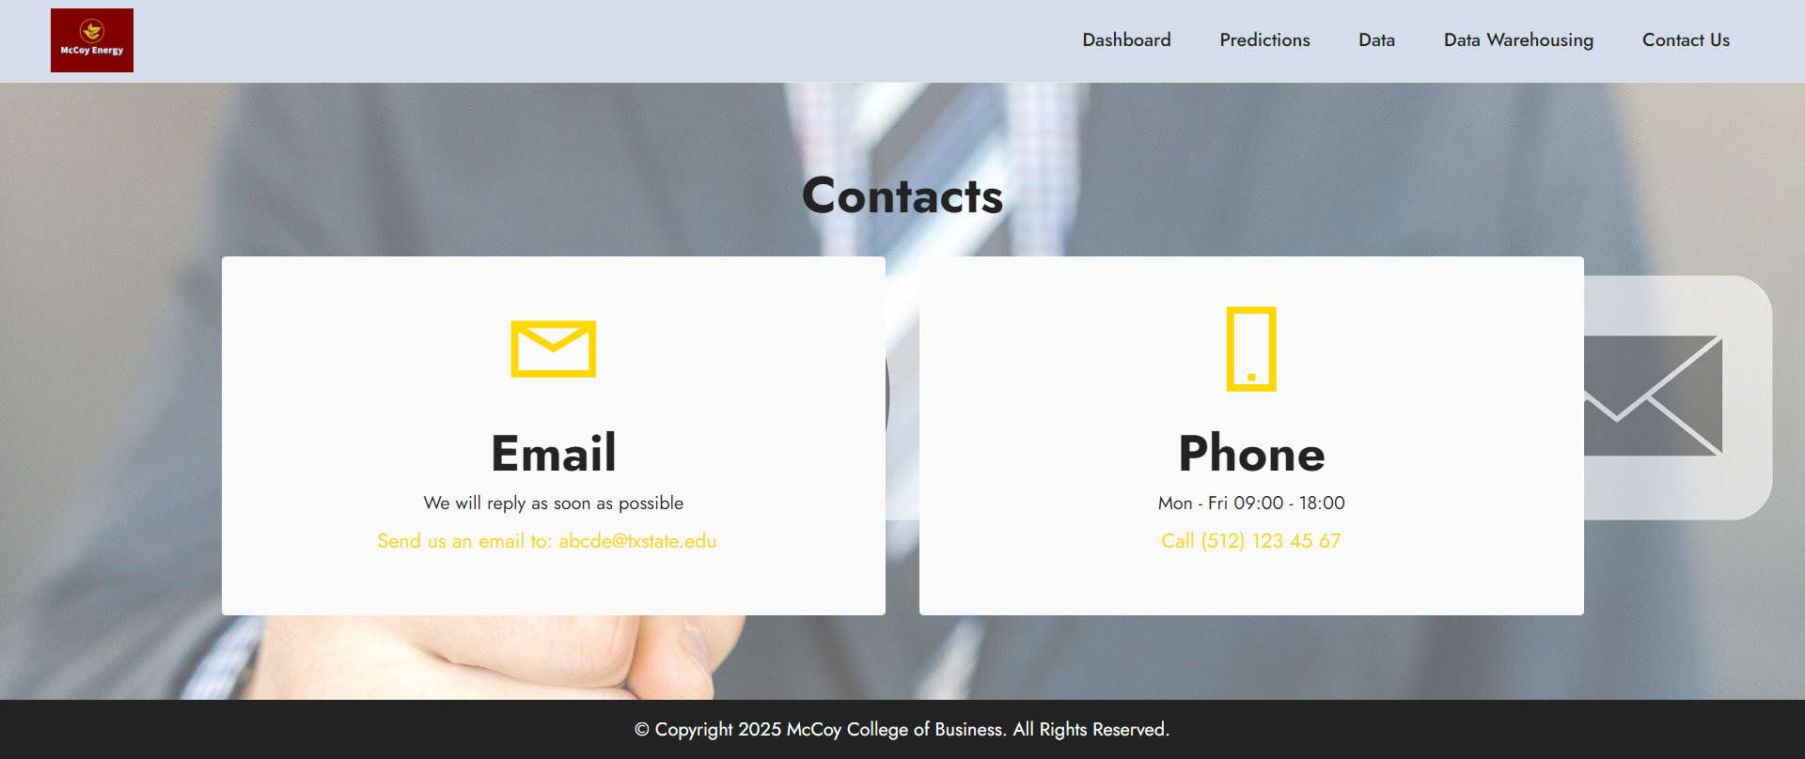
Contact Us Page
Contact Us Page with Email and Phone Number options.

Slide 7
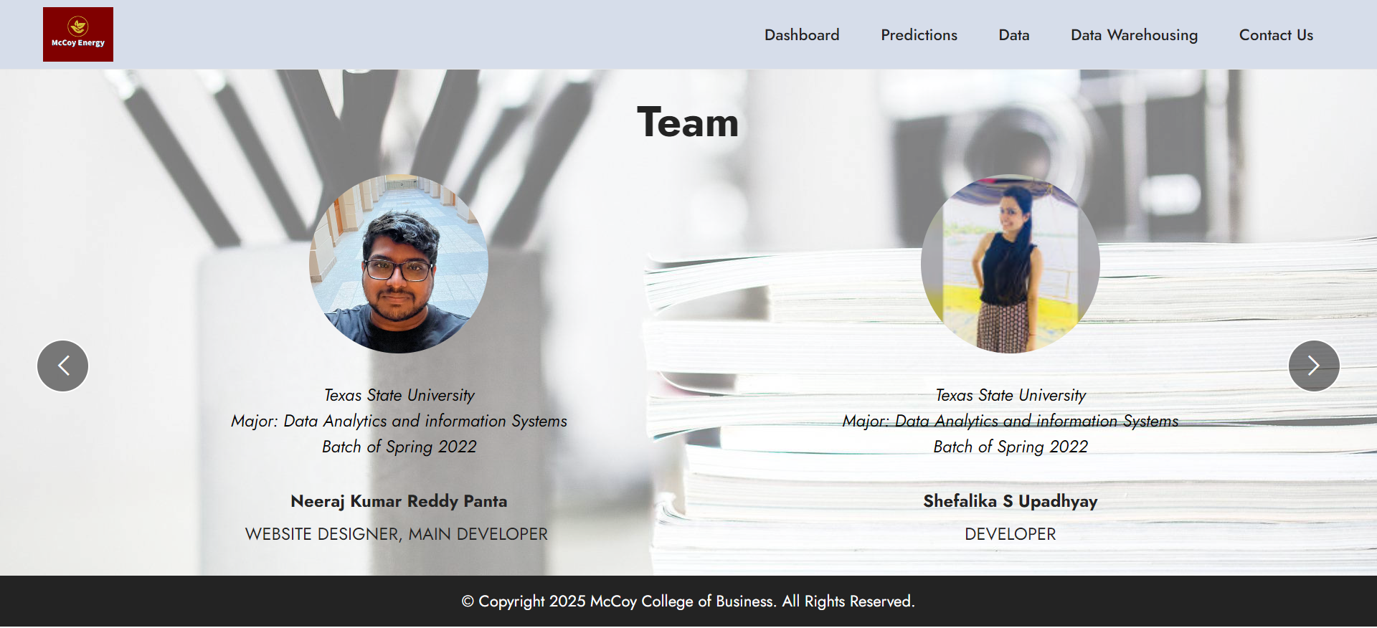
Team

Slide 8
Live Demo of the Dashboard

